Slide 1
Social Procurement initiatives post CV-19
for CV-19 recovery
Dave Colquhoun
Procurement Manager, infrastructure and Sustainable Procurement Lead
dave.Colquhoun@at.govt.nz
021 812-932

Slide 2
Many are asking how and when COVID-19 will end? But as we look longer-term, an equally important question is now vying for the limelight: how exactly do we ‘build back better’ – ensuring we emerge into something more resilient, sustainable and equitable? And more specifically, what can each of us do to ensure it?
Question for today: Time to transform: how are you harnessing disruption to drive lasting change?

Slide 3
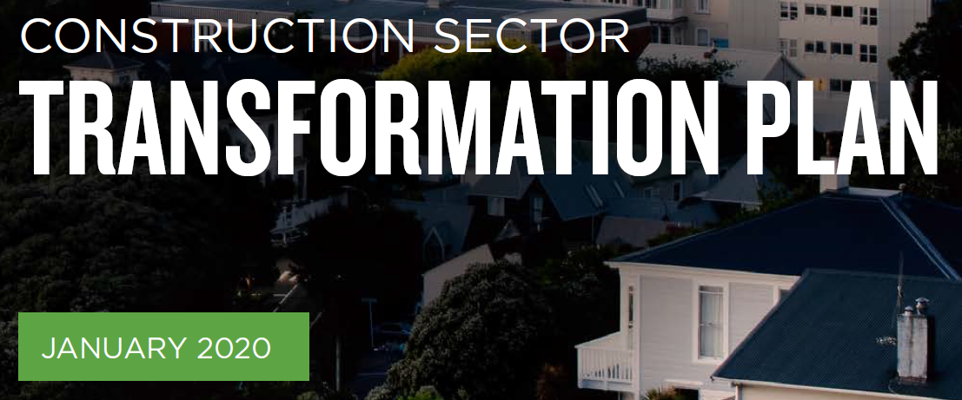
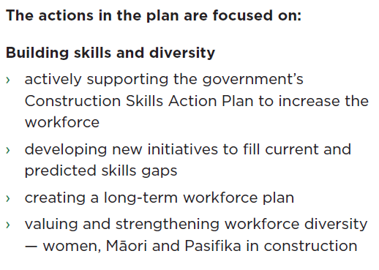
Let’s go back…. Not so long ago
The future of the construction sector is critical to the success of Aotearoa New Zealand. How the sector is organised, supported and led, affects not only the 275,000 New Zealanders who work in it, but also the 4.5 million of us who rely on it for warm, dry and efficient homes, good schools, modern hospitals, safe worksites, and high quality roads and rail.

Slide 5
Has anything changed?

Slide 6
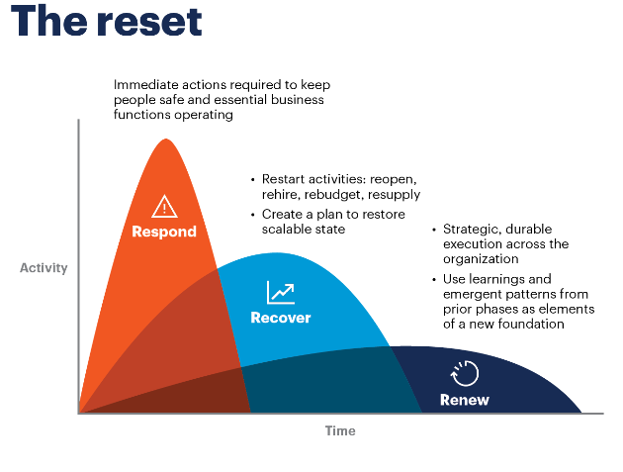

Slide 7
But, past recoveries have actually exacerbated existing problems……

Slide 8
Forum for the Future’s recent Future of Sustainability webinar explored four possible trajectories emerging from COVID-19, each dominated by a different mindset: Disciplined sees a future in which greater tech-enabled control is needed to maintain public health, security and growth – underpinned by a ramped up use of tech, an increase in surveillance and a return to some form of globalisation Collapse sees a future in which we retreated to ‘life as we knew it’, locking in unsustainable practices and prioritising resources for the few over the many Unknown is simply that: a future we’re not yet able to imagine, based on extended periods of disruption.

Slide 9
And then there’s the fourth trajectory: Transform. It’s here we recognise that human health equals planetary health and create a world that is truly regenerative - transformed by systemic change and realising a just transition towards a net zero global economy.
The road to Transform will be turbulent and there are of course, many examples of activities consistent with Collapse and Disciplined.
The more attention we pay to Transform, the greater the chance of it becoming the dominant trajectory, of becoming our future. What we all do, now and over the next six to 12 months, has never mattered more.

Slide 10
So where is your organisation on the trajectory?
Disciplined, Collapse, Unknown, or Transform?

Slide 11
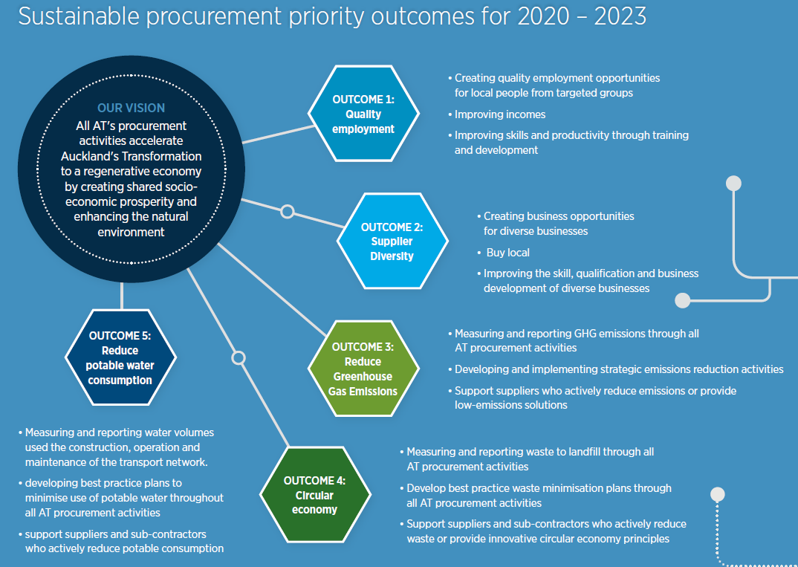
AT is actively using procurement to help deliver priority outcomes and create shared prosperity, including:
Creating employment opportunities
Creating business opportunities for diverse businesses
Buying locally

Slide 12
Initiative Examples

Slide 13
Example: Eastern Busway and Te Whangai Trust. 2020
New Native Plant Nursery in Panmure
Planting provided to the EB programme
Training, employment and pastoral care for long-term unemployed and other vulnerable people

Slide 14
Example: Makaurau Marae upgrade 2020
Lite Civil a 100% Māori owned Business directly engaged with AT, via He Waka Eke Noa

Slide 15
Example: All Heart NZ and corporate furniture repurposing
5780kg of waste diverted from landfill to communities in need
$14,854 Social Return on Investment

Slide 16
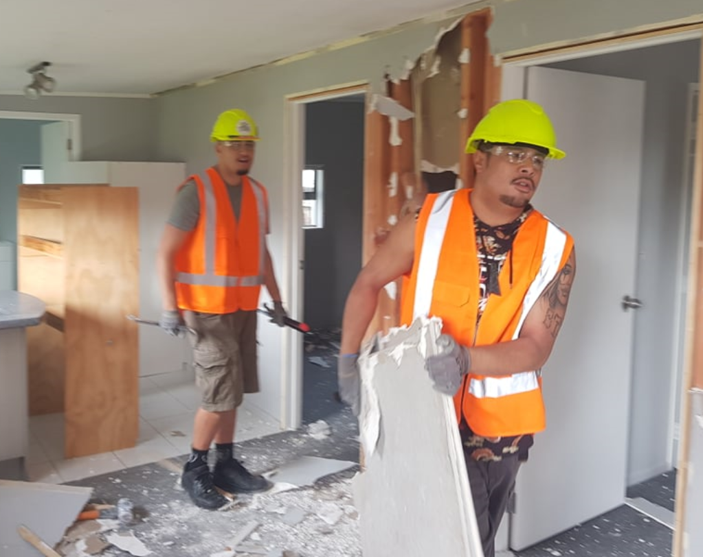
Example: EB2,3,4 – Deconstruction, 2020
Safety 1st engaged (a Māori owned business) via HWEN
Upskilling in Deconstruction (rather than Demolition)
Partnership with AC Waste Minimisation Team
Community waste
Waste diversion TBC

Slide 17
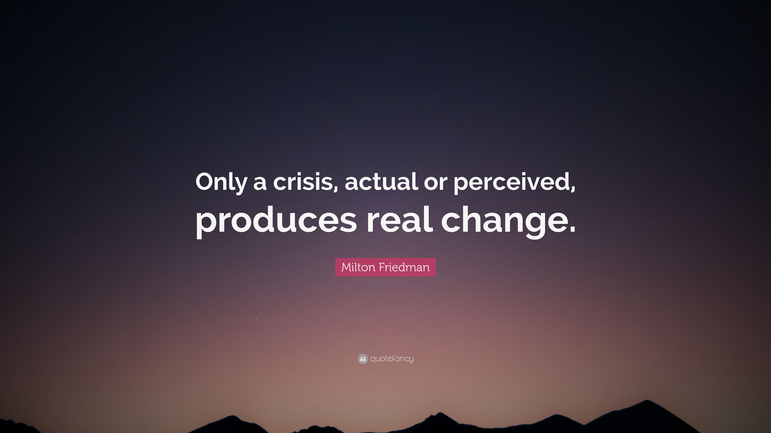
The time is now

Slide 18
Thank you!
Questions?
Notes:
Thank you, happy to take any questions, now, or later after the session.

